Slide 1

Jawahar Education Society’s A. C. Patil College Of Engineering, Kharghar Department Of Artificial Intelligence And Data Science
Major Project Second Progress Presentation.
Lexify: AI Powered Reading Aid for Dyslexic Users
Guide Name: Prof S. B. Pingale
AMRUTA GOLE – 61
ISHITA MORE – 34
GAURESH CHAUDHARI - 63

Slide 2
Introduction:-
Dyslexia is a reading disorder affecting 10%-20% of people worldwide.
It makes it hard to read, write, and understand text, even for intellectual students.
People with dyslexia face problems like slow reading, confusing letters and words, difficulty understanding long sentences, and low confidence in studies.
This project aims to develop an AI-powered text simplification and read-aloud tool to make reading and learning easier and more accessible for them.

Slide 3
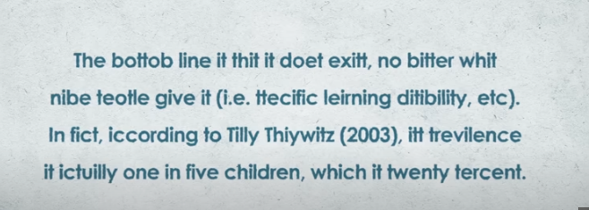
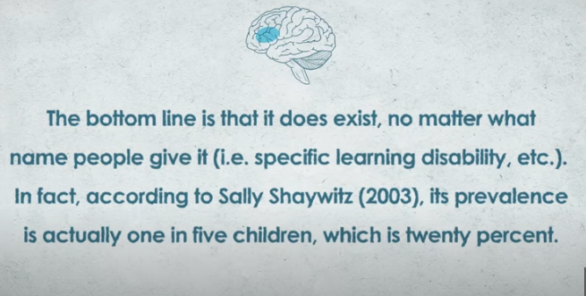

Slide 4
Motivation
Many students with dyslexia struggle to read textbooks and online content, affecting their learning. They are feared by seeing many sentence and difficult words together
Existing support methods like special classes or therapy are costly and not easily available to everyone.
AI can simplify difficult text and read it aloud, making it easier for dyslexic readers to understand and learn independently.
Developing such a tool will help them gain confidence, improve their education, and manage daily reading tasks easily.

Slide 5
Objective
To design and develop an AI-based software that simplifies complex textual content for dyslexic users.
To implement a read-aloud feature that assists dyslexic readers in understanding educational and daily reading materials.
To enhance reading confidence and learning outcomes for dyslexic individuals through accessible technology.
To create a user-friendly and efficient tool that supports inclusivity in education and daily life for people with reading difficulties.

Slide 6
literature Survey
Tittle | Author | Year | Algorithm | Strength | Limitation
1) Let AI Read First: Enhancing Reading Abilities for Individuals with Dyslexia through AI | S. Zhao, S.C. Xiong, B. Pang, X. Tang, P. He | 2025 | Word Embedding-based LLM that generates simplified text annotations. | AI-assisted reading annotations improve comprehension; evaluated on real dyslexic participants; scalable approach | Requires internet and large LLM, high computational cost
2) Use of Recommendation Models to Provide Support to Dyslexic Students | G. Morciano, J.M. Alcalde-Llergo, A. Zingoni, E. Yeguas-Bolívar, J. Taborri, G. Calabrò | 2024 | User-based, item-based, and hybrid recommendation algorithms | Personalizes learning aids; improves engagement; data-driven adaptation | Needs large user data; focuses on tool recommendation, not content
3) A Review of Artificial Intelligence-Based Dyslexia Detection Techniques | Y. Alkhurayyif, A.R.W. Sait | 2024 | Review of ML and DL models (CNN, SVM, Random Forest, etc.) | Comprehensive AI overview; highlights datasets and accuracy ranges; identifies gaps | No new model; focused on detection, not reading support

Slide 7
literature Survey
Tittle | Author | Year | Algorithm | Strength | Limitation
4) AI-Enhanced Child Handwriting Analysis: A Framework for Early Screening of Dyslexia and Dysgraphia | M.K. Bhatt, N.R. Patel, P.K. Raval | 2025 | CNN + ML-based handwriting feature extraction and pattern analysis | Novel handwriting-based detection; combines motor and linguistic cues; early diagnosis potential | Dataset limited to children; not focused on reading/writing assistance
5) Towards Inclusive Reading: A Neural Text Generation Framework for Dyslexia Accessibility | E. Madjidi, C. Crick | 2024 | Word embedding fine-tuned for text simplification, phonetic segmentation, and accessible text generation | Directly generates accessible English text; improves comprehension; linguistic + neural approach | Small user group ; English-only model
6) SimpLex: A Lexical Text Simplification Architecture | C.-O. Truică, A.-I. Stan, E.-S. Apostol | 2025 | Word Embedding (Word2Vec) and Transformer-based (BERT, RoBERTa, GPT-2) simplification | Modular design; supports both lightweight and advanced approaches; high simplification quality | No dyslexic user testing; focused on lexical simplification only; high computational need for transformer

Slide 8
Analysis of Review
Most studies focused on dyslexia detection and classification, not on real-time reading support.
Works like SimpLex and Neural Text Generation Framework simplified text but missed personalization, speech output, and adaptive UI.
High computational demand and internet dependency limited practical usability of earlier systems.
Recommendation-based sytems improved engagement but didn’t simplify reading material itself.
Few systems offered dyslexia-friendly fonts, spacing control, or auditory feedback.
Lexify bridges these gaps by integrating transformer-based simplification, text-to-speech, and a customizable, user-friendly interface for complete reading support.

Slide 9
Research Gap
1) Current tools are not made for dyslexic readers.
Lexify fix: It will simplify text in a dyslexia-friendly way (shorter sentences, simpler words, clearer structure).
2) Tools do only one job.
Lexify fix: Combines simplify + read aloud + personalization in one app.
3) No real-time personalization
Lexify fix: It will adapt automatically to each user (adjust speed, font, or level of simplification).
.
4) Fixed reading speed
Lexify fix: Allows adaptive speed control (slows down on complex words, speeds up on simple parts).

Slide 10
Research Objective
To develop an AI-based text simplification system that can automatically convert complex English paragraphs into simpler, dyslexia-friendly text without losing meaning.
To integrate a personalized text-to-speech (TTS) module enabling users to listen to simplified text in real time with adjustable voice speed and tone.
To build a dyslexia-friendly user interface that uses OpenDyslexic font, spacious layout, and customizable color themes to enhance readability.
To contribute toward accessible AI applications that improve reading comprehension and inclusivity for individuals with learning differences.

Slide 11
Problem statement
Dyslexic readers face difficulty in understanding complex texts, and existing tools do not provide both text simplification and read-aloud features together. There is a need for a simple AI tool to make reading and learning easier for them.

Slide 12
Proposed System
User Login & Access Control
User will loged into his/her account and can access their personalised settings.
Text Input & Preprocessing
It is Backend part. Input may be pasted text, uploaded documents, or web content.
Preprocessing steps include tokenization, lemmatization, POS tagging, and sentence segmentation.
Complexity Prediction (Backend): Detects difficult or complex words for readers.
Complexity will be seen by factors like length of word, syllabic complexity, Semantic Complexity.
Algorithm used: DistilBERT (fine-tuned transformer)

Slide 13
Text Simplification Engine:
Synonym Generation: Candidate simpler words are generated using WordNet and transformer language models.
Synonym Selection: Candidates are ranked using SentenceTransformer and Readability Score
Sentence Generation & Ranking: T5 (Text-to-Text Transfer Transformer). T5 can paraphrase and rebuild the whole sentence while preserving meaning..
Accessibility & Personalization:
The simplified text is displayed in OpenDyslexic font, with adjustable spacing and background color schemes chosen by the user.
Text-to-Speech Module

Slide 14
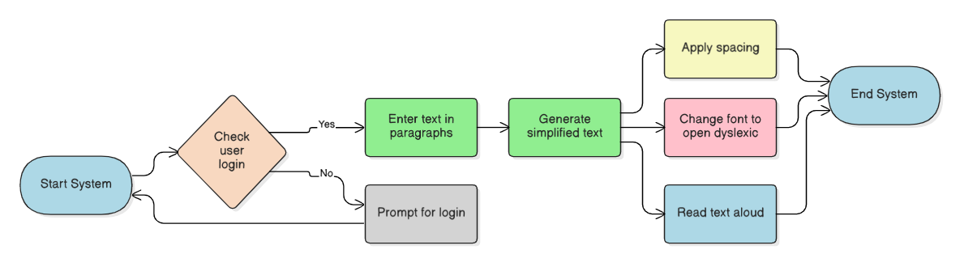
Architecture

Slide 15
System Design (Modules)
Module 1: Text Preprocessing: Tokenization, lemmatization, POS tagging.
Module 2: Complexity Predictor: Classifies words into complex vs simple.
Module 3: Synonym Generator: Generates alternative simpler words.
Module 4: Synonym Selection : Chooses best candidate based on semantic similarity + frequency.
Module 5: Sentence Simplification: Replaces words and ranks sentences.
Module 6: Presentation Layer: Applies dyslexia-friendly design.
Module 7: Text-to-Speech

Slide 16
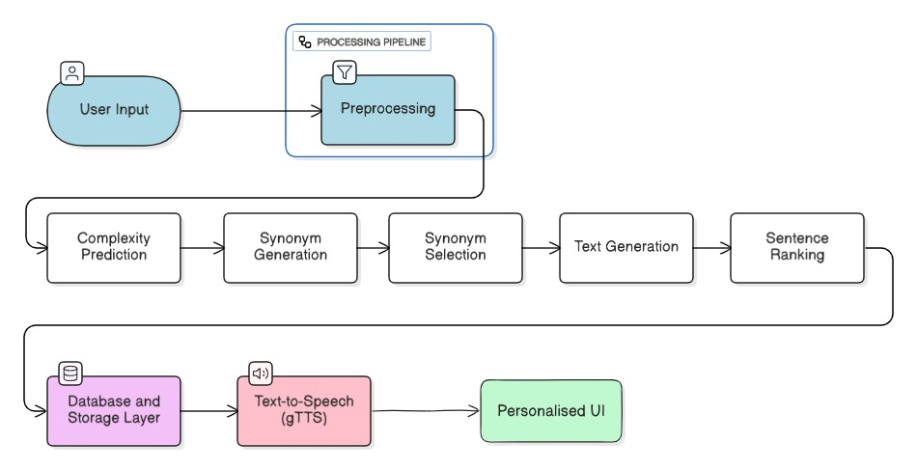

Slide 17
Algorithms
1. Input & Preprocessing
Tokenization → NLTK / SpaCy.
Lemmatization & POS tagging → SpaCy.
Sentence splitting → NLTK/SpaCy.
2. Complexity Prediction (Finding “hard words”)
Fine tuning using DistilBert
3. Synonym Generation
WordNet + BERT contextual filtering

Slide 18
4. Synonym Selection (Choosing the best candidate):
Chooses the best possible synonym among candidates.
Algorithm: SentenceTransformerand Readability Score.
5. Candidate Sentence Generation:
Replace complex word with candidate synonyms.
Algorithm Used: T5 (Text-to-Text Transfer Transformer)
6. Sentence Ranking (Selecting the final version)
Evaluates multiple simplified outputs and picks the best
Algorithm Used: BARTScore. BARTScore considers both semantic similarity and fluency.

Slide 19
7. Presentation Layer
Formatting: OpenDyslexic font, custom color scheme, extra spacing.
Text-to-Speech:
Lightweight → gTTS (Google Text-to-Speech).
8. Evaluation:
SimpLex achieved a SARI score of ~38–42, showing good simplification quality but limited contextual fluency.
Lexify integrates T5 ,BARTScore aiming for SARI 45+ with higher semantic retention and readability.
By adding context-aware simplification, speech output, and personalized interface, Lexify enhances both model accuracy and user experience.

Slide 20
Dataset
1. For Word Complexity Prediction
Use: CWIG3G2 dataset(Wikipedia,newsarticle)
2. For Sentence / Paragraph Simplification
Use: WikiLarge Dataset : Biography / Educational Articles
3. For Evaluation
Use: WikiNet - test split

Slide 21
HARDWARE & SOFTWARE
Hardware Requirements
Processor: Minimum Dual/Quad-Core CPU
RAM: At least 8 GB
Storage: 50 GB free space
GPU (Optional): NVIDIA GPU with CUDA support for fine-tuning models
I/O Devices: Keyboard, mouse, display, and speakers/headphones

Slide 22
SOFTWAFRE
Software Requirements
Programming Language: Python
Frameworks/Libraries: Transformers, SentenceTransformers, NLTK, WordNet, gTTS, Flask/Streamlit
Database: SQLite or Firebase
Development Tools: Jupyter Notebook / VS Code / Google Colab
Version Control: Git and GitHub
Operating System: Windows / macOS / Linux

Slide 23
Conclusion
This project not only simplifies text but improves reading fluency, vocabulary, and confidence in dyslexic users — enabling them to read and learn independently, which in turn boosts their cognitive growth. And it’s not limited to one platform — it’s a scalable solution that can be integrated into browsers, learning platforms, and even public reading apps.

Slide 24
References
[1] S. Zhao, S. C. Xiong, B. Pang, X. Tang, and P. He, “Let AI Read First: Enhancing Reading Abilities for Individuals with Dyslexia through Artificial Intelligence,” arXiv preprint arXiv:2504.00941, 2025.
[2] G. Morciano, J. M. Alcalde-Llergo, A. Zingoni, E. Yeguas-Bolívar, J. Taborri, and G. Calabrò, “Use of Recommendation Models to Provide Support to Dyslexic Students,” arXiv preprint, 2024.
[3] Y. Alkhurayyif and A. R. W. Sait, “A Review of Artificial Intelligence-Based Dyslexia Detection Techniques,” Diagnostics, vol. 14, no. 21, p. 2362, Oct. 2024.
[4] M. K. Bhatt, N. R. Patel, and P. K. Raval, “AI-Enhanced Child Handwriting Analysis: A Framework for the Early Screening of Dyslexia and Dysgraphia,” SN Computer Science, vol. 6, no. 3, pp. 1–13, 2025.
[5] E. Madjidi and C. Crick, “Towards Inclusive Reading: A Neural Text Generation Framework for Dyslexia Accessibility,” Proceedings of the 10th International Conference on Data Science and Artificial Intelligence (DSAI), Porto, Portugal, 2024.
[6] S. Parmar and C. Paunwala, “Early Detection of Dyslexia Based on EEG with Novel Predictor Extraction and Selection,” Neural Processing Letters, vol. 55, pp. 1465–1482, 2023.
[7] C.-O. Truică, A.-I. Stan, and E.-S. Apostol, “SimpLex: A Lexical Text Simplification Architecture,” Neural Computing and Applications, vol. 35, no. 8, pp. 6265–6280, 2023.

Slide 25
THANK YOU!

